Slide 1

DCM for EEG - Tutorial
Dr. Ashley Tyrer
Centre for Functionally Integrative Neuroscience
Aarhus University

Slide 2
Overview
Brief recap of Dynamic Causal Modelling
Introduction to the example data
Walkthrough of DCM pipeline in SPM GUI
Independent working time, generate a DCM
Walkthrough of options to view results
Bayesian Model Selection
AIM: Estimate effective connectivity between sources of neural activity, in the context of a visual repetition memory paradigm

Slide 3
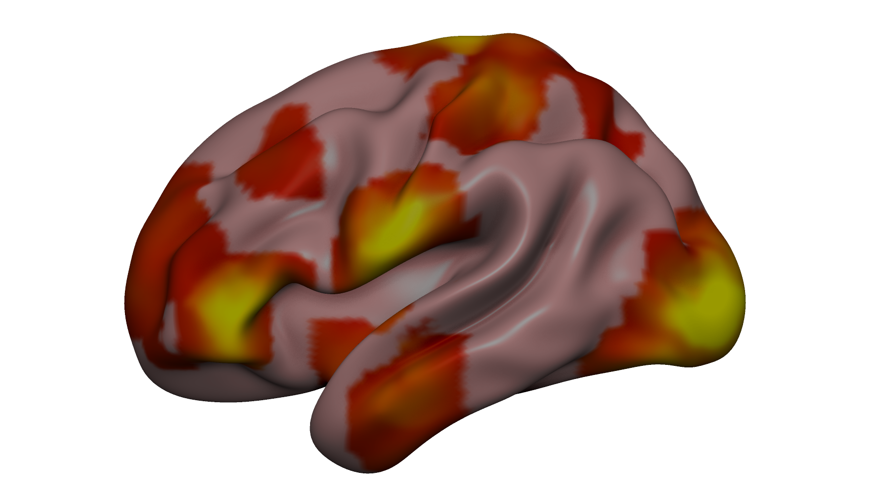
Recap of DCM
Hypothesis driven method
Measures ‘effective connectivity’
Yields an approximation to log model evidence:
compare alternative models of the same data
Make statistical inferences about which model best represents the data, i.e. has the highest model evidence, through Bayesian Model Selection (calculate Bayes factor)
Functional connectivity
Effective connectivity
Task modulated connection
p (y | m)

Slide 4
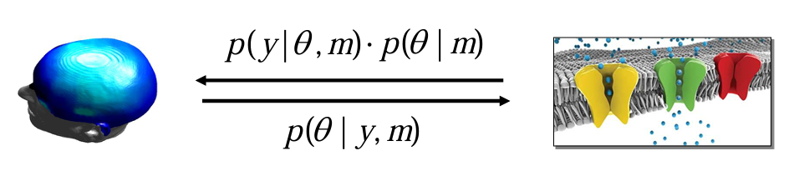
Forward model: Predicting measured activity
Inverse model: Inferring neuronal parameters
Stephan, et al. 2017

Slide 5


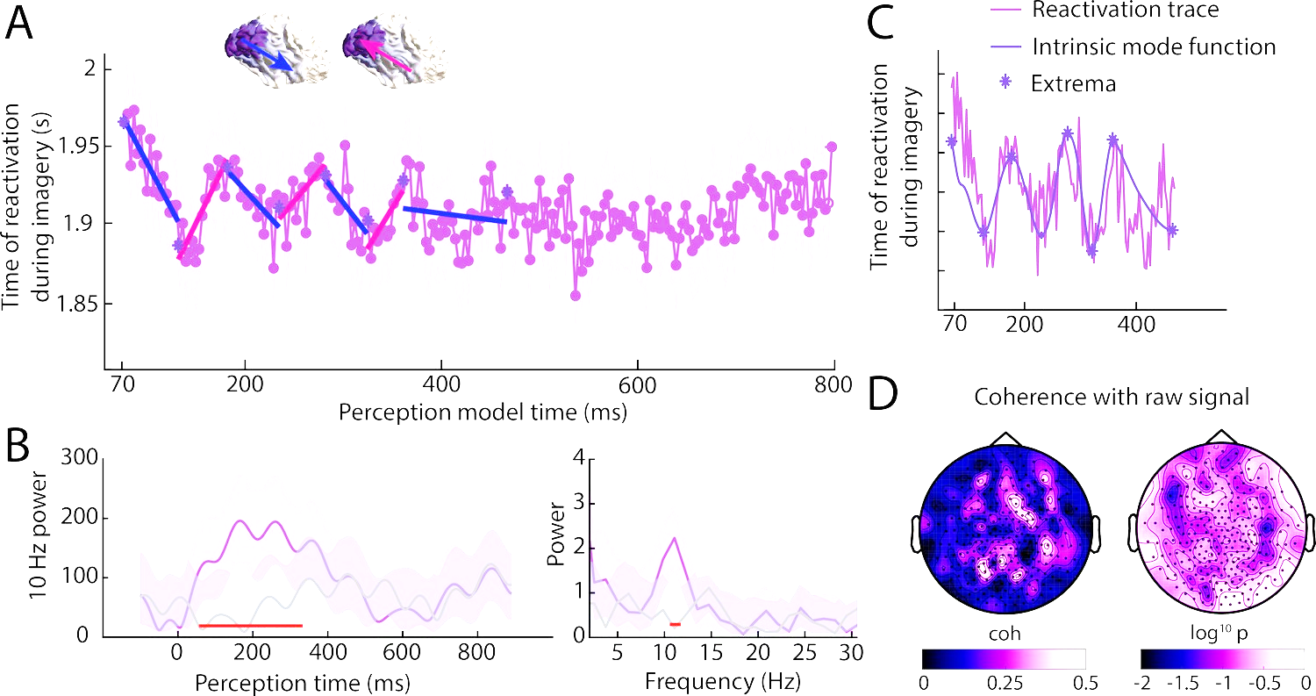
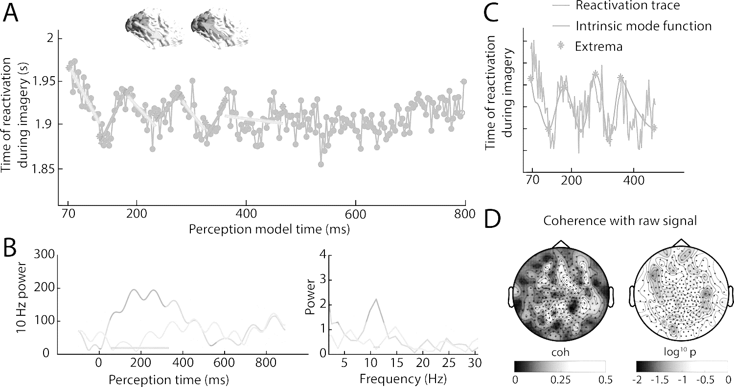
3D Source Reconstruction
Dynamic Causal Modelling
p (θ | y, m)
L
R
model parameters
model
condition 1
condition 2
observed data
Task modulated connection
Amplitude (μV)
Time (ms)
Amplitude (μV)
Amplitude (μV)
model
data
Patient
Time (ms)
Time (ms)

Slide 6
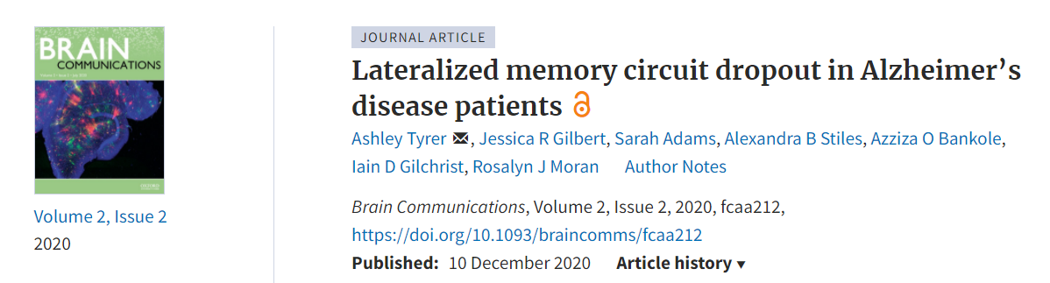

Example data:
Download:
@AshleyTyrer
github.com/AshleyTyrer/DCM_for_ERPs
Notes:
KEY AIMS: to investigate how inter-regional connectivity and within-region dynamics during implicit and explicit memory processing are implicated in Alzheimer’s disease, and to examine whether such connections in the right hemisphere provided compensation during these memory tasks.
MAIN HYPOTHESIS: hierarchical left-hemisphere specific connections may be weakened in the Alzheimer’s patient cohort compared with healthy aged controls.

Slide 7



Analysis Pipeline
Visual Recognition Task
Novel vs Repeated images
Raw Data: 64-channel EEG
Instructions
Pre-processing:
Band-pass filter (2-30 Hz)
Epoching (-52-500 ms)
Manual artefact correcting
~2 sec
Source
Identification
“repeated”
…
DCM
“novel”
Tyrer, et al. 2020

Slide 8
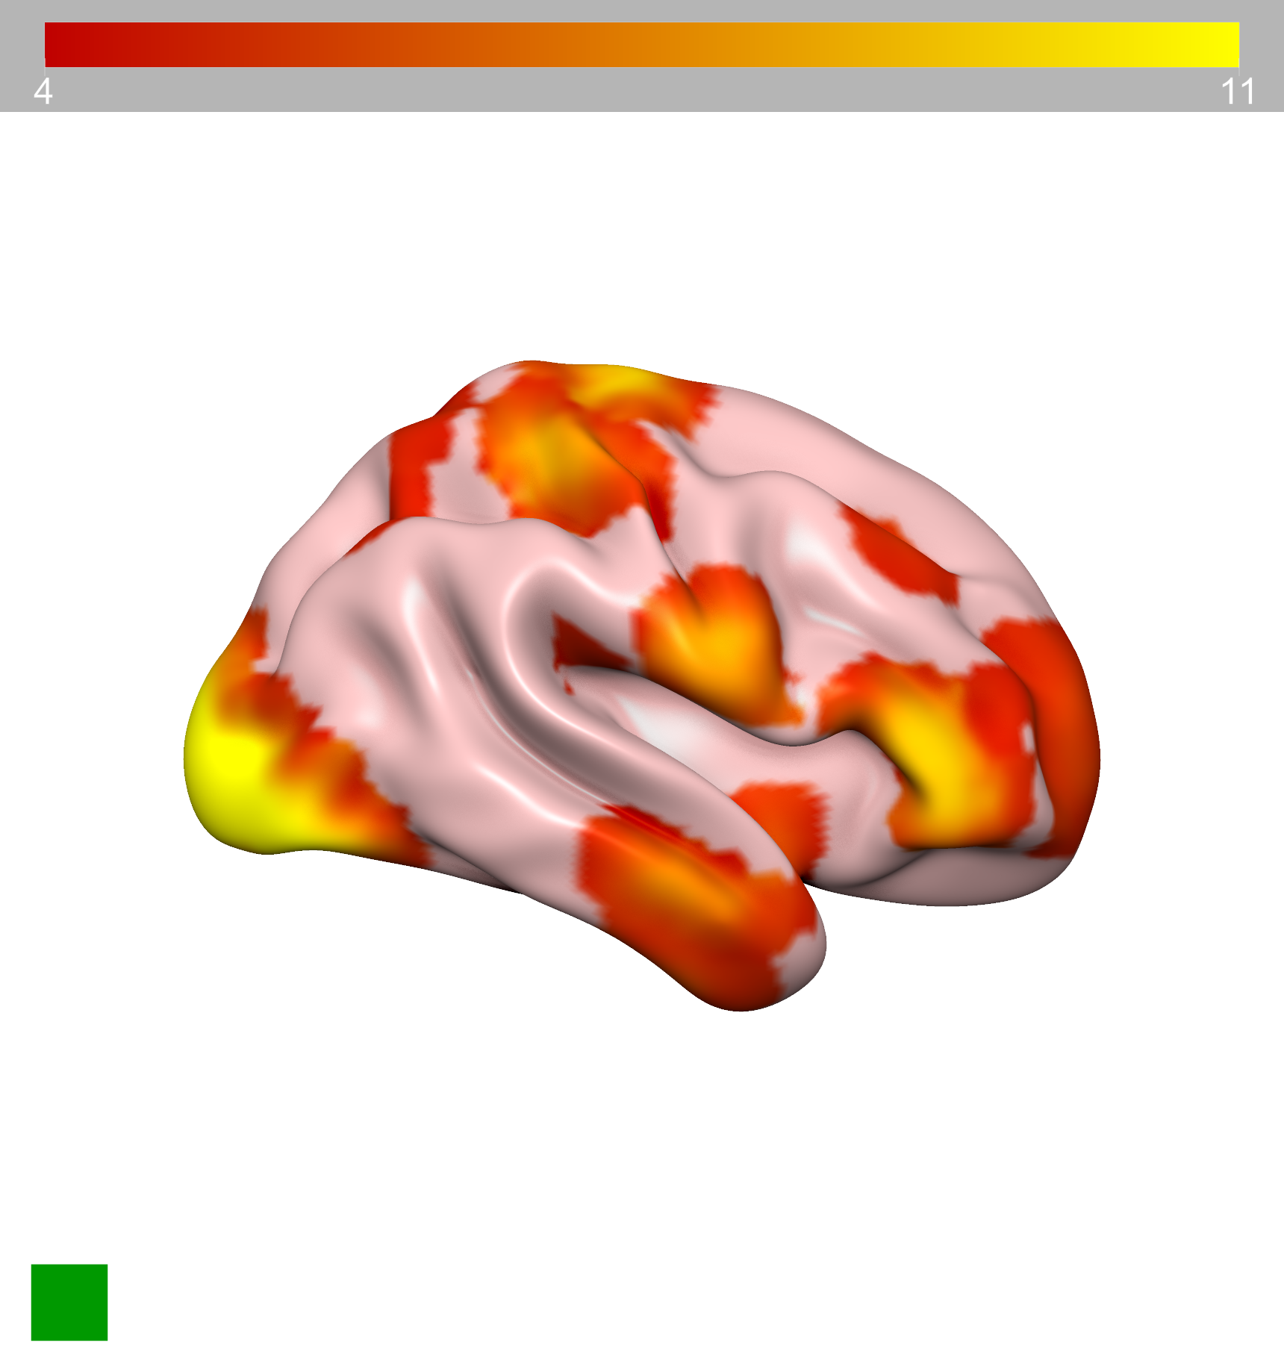
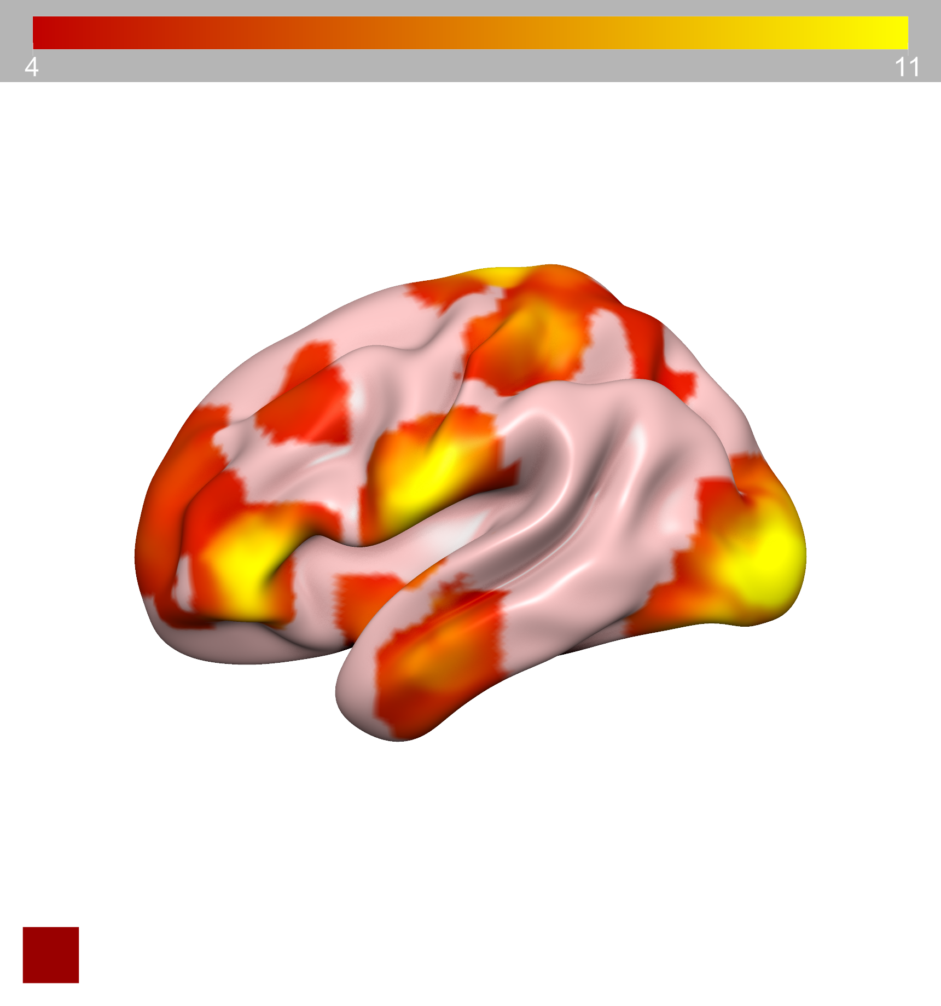
A (forward) =
[ 0 0 0 0 0 0
0 0 0 0 0 0
1 0 0 0 0 0
0 1 0 0 0 0
0 0 1 0 0 0
0 0 0 1 0 0 ]
B (modulatory) =
[ 1 0 1 0 0 0
0 1 0 1 0 0
1 0 1 0 1 0
0 1 0 1 0 1
0 0 1 0 1 0
0 0 0 1 0 1 ]
Source Identification
IFG
IFG
5
6
Z score
ITG
ITG
R. OCP
A (backward) =
[ 0 0 1 0 0 0
0 0 0 1 0 0
0 0 0 0 1 0
0 0 0 0 0 1
0 0 0 0 0 0
0 0 0 0 0 0 ]
C (inputs) =
[ 1 1 0 0 0 0 ]
3
4
L. OCG
L. IFG
L. ITG
R. ITG
R. IFG
OCG
OCP
1
2
Subcortical Input
Source selection in line with previous analyses (Gilbert and Moran, 2016)
Tyrer, et al. 2020

Slide 9
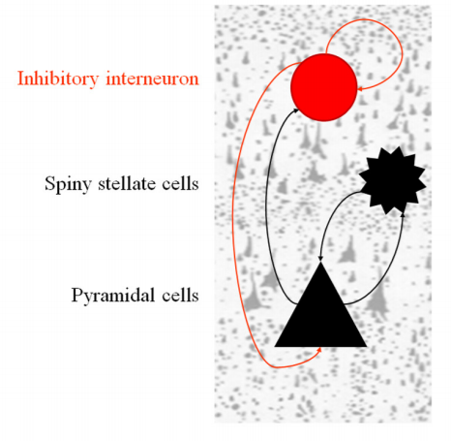
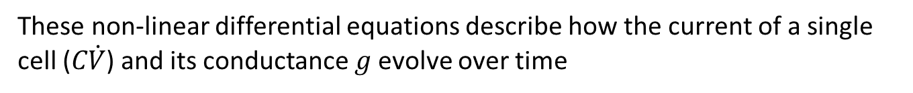
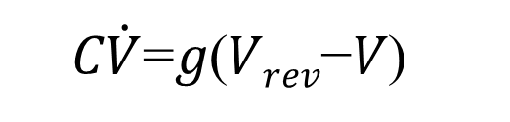
Inverse Model:
Conductance-based Neural Mass Model
p (θ | y, m)
model parameters
model
observed data
Morris-Lecar Non-Linear DEs:
𝐶$\dot{V}$=𝑔(𝑉_{𝑟𝑒𝑣}−𝑉)
These non-linear differential equations describe how the current of a single cell (𝐶$\dot{V}$) and its conductance 𝑔 evolve over time
Moran, et al. 2013

Slide 10
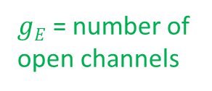
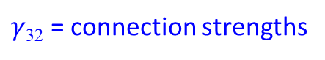
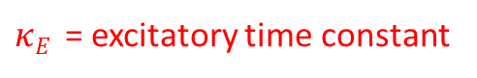
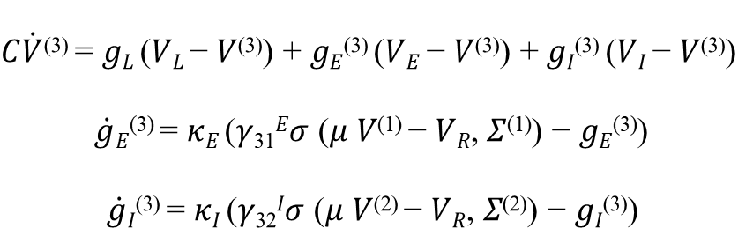
Inverse Model:
Conductance-based Neural Mass Model
p (θ | y, m)
model parameters
model
observed data
Excitatory Pyramidal Cells
$$\text{C}\dot{V}\text{(3)} \text{=} \text{g}\text{L} \text{(}\text{VL} \text{−} \text{V}\text{(3)}\text{)} \text{+} \text{g}\text{E}\text{(3)} \text{(}\text{VE} \text{−} \text{V}\text{(3)}\text{)} \text{+} \text{g}\text{I}\text{(3)} \text{(}\text{VI} \text{−} \text{V}\text{(3)}\text{) }$$
$\dot{g}\text{E}\text{(3)} \text{=} \text{κ}\text{E} \text{(}\text{γ}\text{31}\text{E}\text{σ} \text{(}\text{μ} \text{V}\text{(1)} \text{−} \text{V}\text{R}\text{,} \text{Σ}\text{(1)}\text{)} \text{−} \text{g}\text{E}\text{(3)}\text{) }$
$$\dot{g}\text{I}\text{(3)} \text{=} \text{κ}\text{I} \text{(}\text{γ}\text{32}\text{I}\text{σ} \text{(}\text{μ} \text{V}\text{(2)} \text{−} \text{V}\text{R}\text{,} \text{Σ}\text{(2)}\text{)} \text{−} \text{g}\text{I}\text{(3)}\text{)}$$
$\text{κ}\text{E}$ = excitatory time constant
$\text{g}\text{E}$ = number of
open channels
$\text{γ}\text{32}$ = connection strengths
Moran, et al. 2013
Notes:
Cell subpopulation 1: excitatory spiny stellate cells (granular layers – layer 4)
Cell subpopulation 2: inhibitory interneurons (extra-granular layers)
Cell subpopulation 3: excitatory pyramidal cells (extra-granular layers)
Other types of conductance-based DCM also contain deep pyramidal cells (cell subpopulation 4)

Slide 11
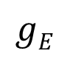
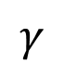
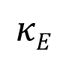
$$\text{g}\text{E}$$
$$\text{κ}\text{E}$$
$$\text{γ}$$

Slide 12
Summary
Pre-Processing
Band-pass filtering (2-30 Hz)
Epoching (-52-500ms PST)
Manual artefact correcting
Source Identification using 3D source reconstruction
Dynamic Causal Modelling – conductance-based NMDA model
Bayesian Model Selection – fixed effects
Further Analyses, e.g. Parametric Empirical Bayes
Determine parameters associated with task performance, disease state, on the group level

Slide 13

Thank you for listening
@AshleyTyrer
@AshleyTyrer

